Slide 1
Healthy Communication
Strategies
Presentation by Kayla Newkirk and Janay Jones, Master’s Level Interns

Slide 2
What to Expect:
Learn about communication styles
Learn about communication skills
Learn about nonverbal communication skills
Learn about communication barriers
Learn about resources to help you gain and practice skills

Slide 3
DISCLAIMER
The information provided in this PowerPoint is not a replacement for professional counseling and is for informational use only.

Slide 4
BRANCHES OF GROWTH MENTAL HEALTH COUNSELING & YOGA STUDIO
is a holistic based mental health practice located in central New York. We service ages 6+, both in person and telehealth, and specialize in working with anxiety, depression, PTSD, grief and loss, substance abuse, stress management, relational issues, etc.
We also have a beautiful yoga studio, where we offer specialty yoga classes, Reiki Energy Healing and Sound Healing services.
1
5
2
4
6
Elaborate on what you
want to dicuss.

Slide 5
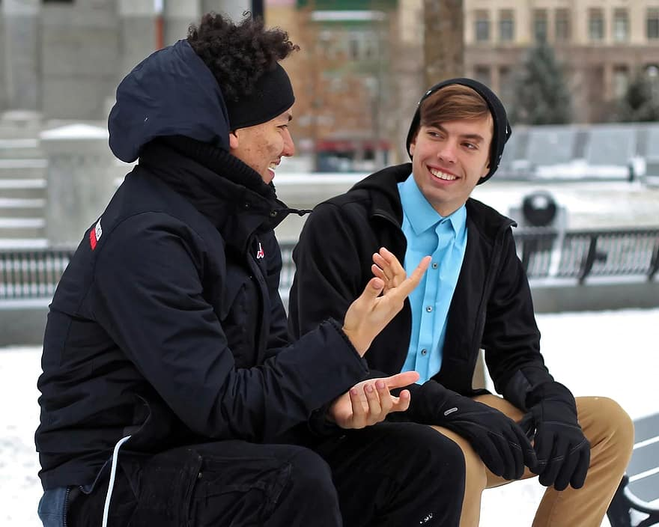
What is communication?
the imparting or exchanging of information or news (dictionary.com)
Give, Receive, and Share Information
Senders, messages, and recipients
Feedback
Feedback brings us confirmation that the message is understood and heard accurately
Through reading, writing, listening, and/or reading
Roles are important when passing a conversation back and forth

Slide 6
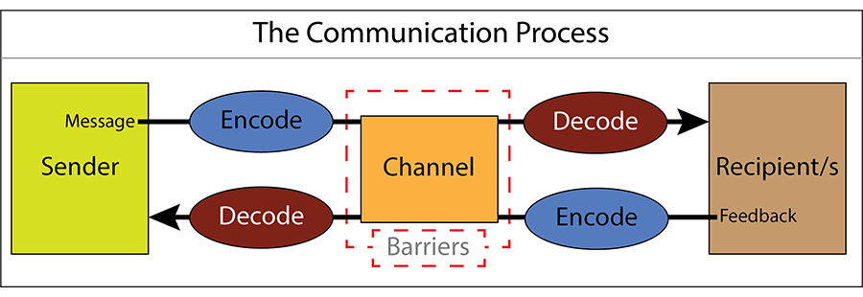
The Communication Process

Slide 7
The Importance of Feedback
Ways to ensure that communication has been effectively received:
Ask a quick question such as:
“Is that okay?” or “Are you clear about that?”
For more detailed feedback, ask if you can go over it one more time for clarity.

Slide 8
What is active listening?
Active listening is a communication skill that involves going beyond simply hearing the words that another person speaks but also seeking to understand the meaning and intent behind them. It requires being an active participant in the communication process.
www.verywellmind.com

Slide 9
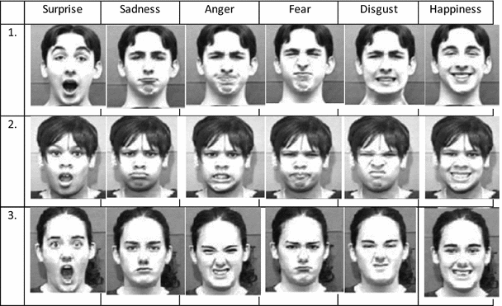
The Importance of Nonverbal Communication

Slide 10
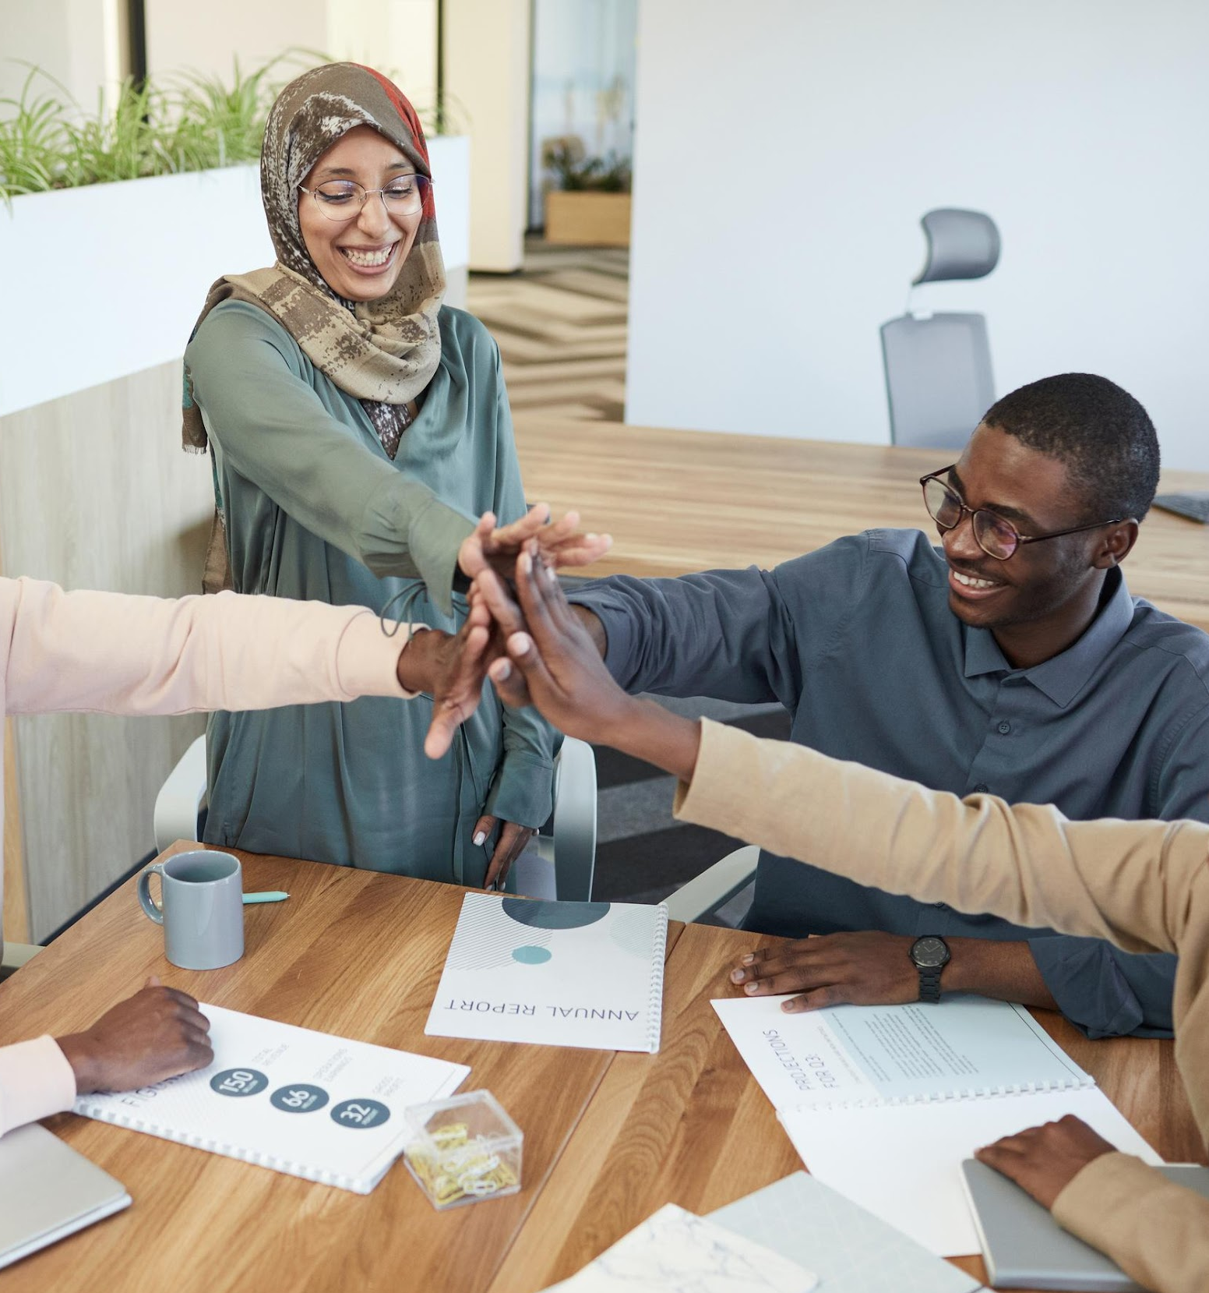
7%
Communication is through verbal interactions
55%
Through body language
38%
Through tone and pitch
https://blog.gitnux.com/communication-skills-statistics

Slide 11
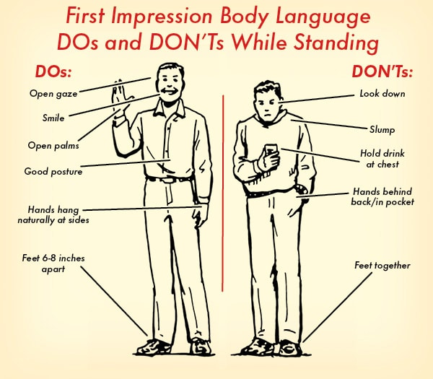
Body Language Tips
What message do you receive when looking at the person on the right versus the person on the left?

Slide 13
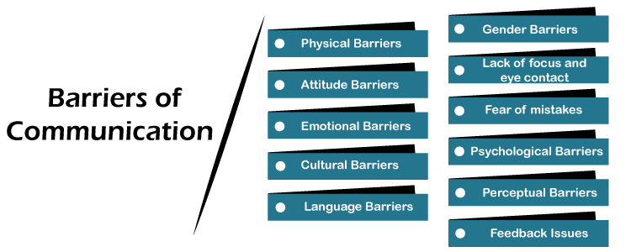
Communication Barriers

Slide 14
How Culture impacts Communication

Slide 15
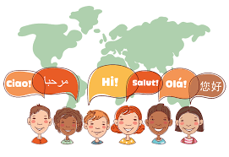
What is Cultural Communication?
Culture can be defined as the beliefs, behaviors, norms, values, attitudes, customs, rules, and language that people share in a particular area or group.
Cultural differences that manifest in communication refer to the variations observed between people engaging in a conversation due to differences in their values, beliefs, norms, and behaviors.
One can address these differences and communicate effectively by being more culturally sensitive.
https://study.com/learn/lesson/cultural-differences-communication-impact-importance-examples.html

Slide 16
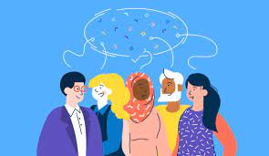
How Culture Impacts Communication
Communicating with different words, phrases, gestures, and the way that they apply it in conversation
This can also affect the way that they resolve conflicts because some cultures accept conflict and others find them undesirable
Individuals from different cultures approach conversations differently when delivering and inquiring information
Some cultures accept different vocabulary compared to others
Decision-making can look different. Some examples include empowering people to make their own decisions, others focus on making decisions based upon family or their elders.

Slide 17
Addressing Cultural Considerations
Cultural sensitivity refers to the awareness of commonalities and variations in people's cultures without labeling them as desirable or undesirable.
Being culturally sensitive requires understanding that the similarities and variations in people impact their behaviors, perceptions, and values.
This enables a person to adjust behaviors to be at par with people from a different culture.

Slide 19
The Impact of effective Communication

Slide 20
Benefits of Communication Skills in the Workplace
Enhances productivity up to 30%
Improves relationships with coworkers and colleagues
Decreases poor results in errors or failed projects
Increases the chance of accruing more money annually
And more!

Slide 21
?

Slide 22
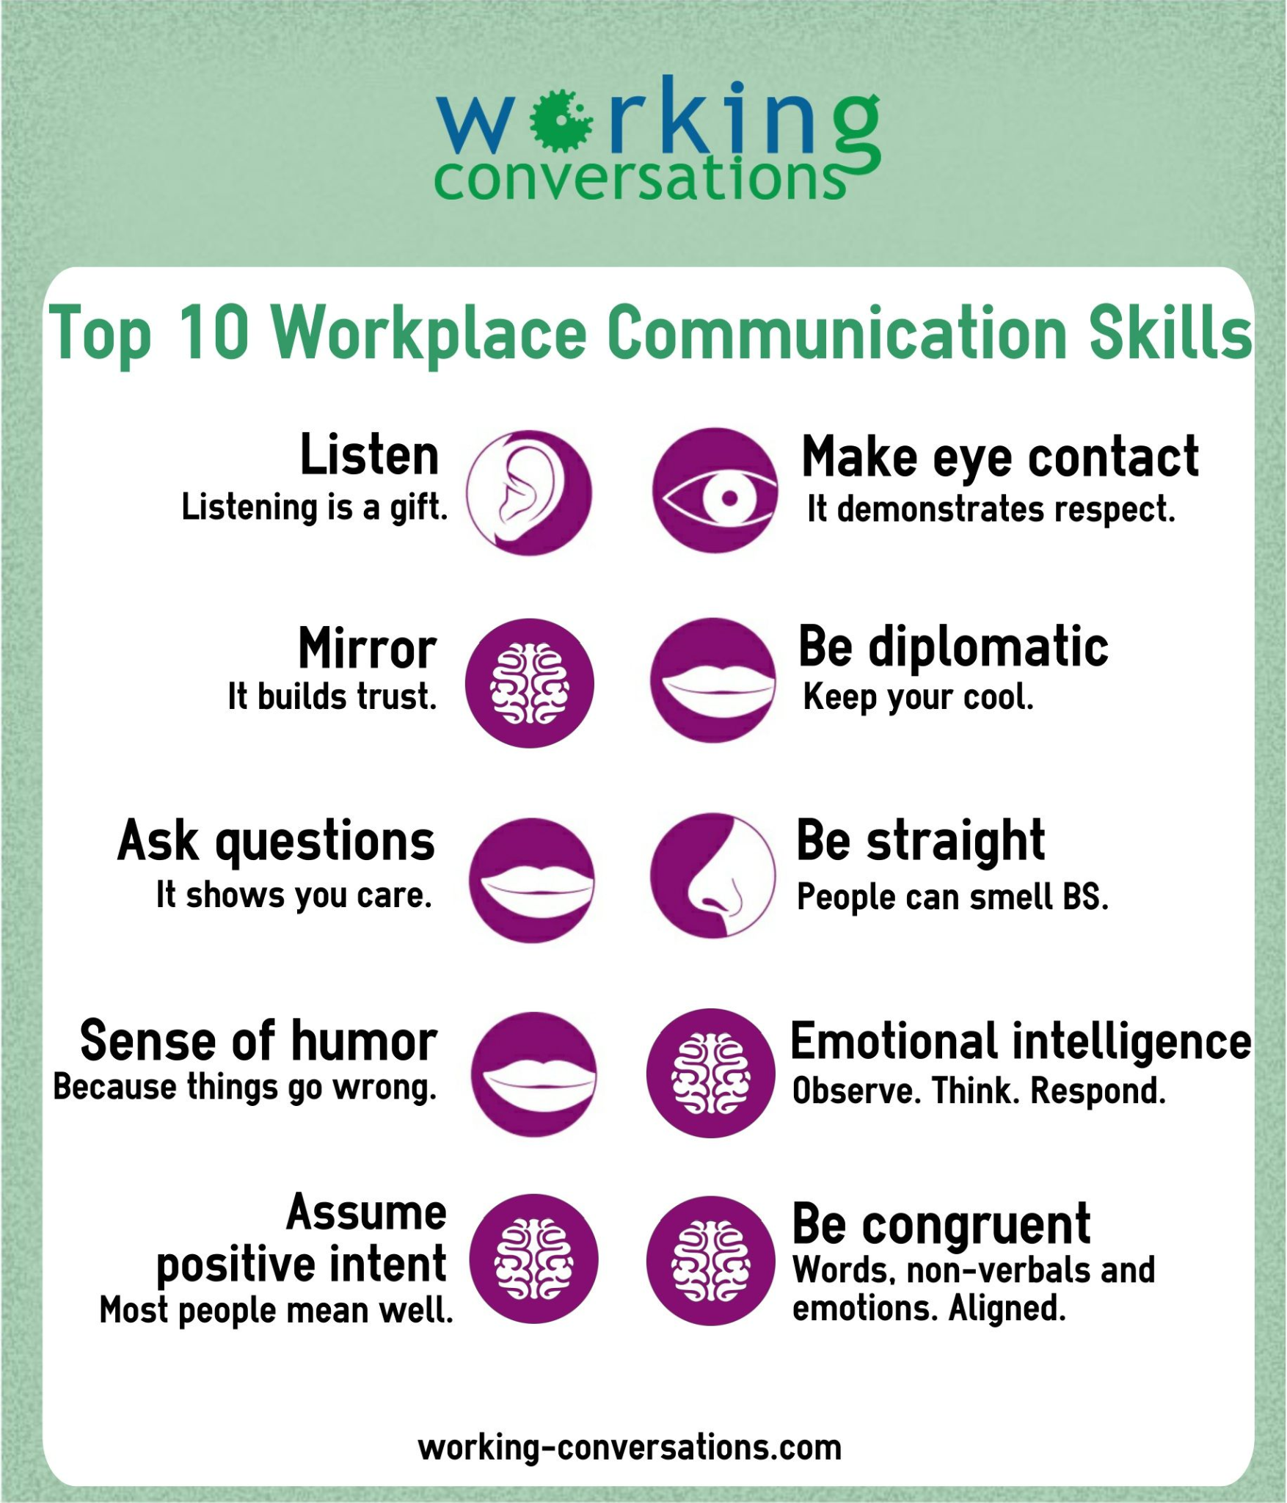

Slide 23
What does
“approachable”
Look like

Slide 24
Body Posturing that Encourages Communication
Level of Comfort
Open Posture
Closed Posture
Raise self-awareness
Having open posture helps us feel comfortable and confident, which can help others perceive in a positive way.
Palms facing forward, arms apart, chest out, and chin up.
Can be perceived as uncomfortable and set the tone for the conversation. This includes legs crossed, hands touching hair, arms crossed, and bending to take less space.
What message are you trying to convey? How can you help yourself and others become more comfortable?

Slide 25
Communication Styles
Can be favored depending on culture, individual personality, and social environment
Having an assertive style can be the most effective when expressing individual needs and acknowledging the needs of others
Passive communication can be helpful when conflict is becoming violent
Some cultures accept a passive communication style over an assertive one because of the needs being focused on the family versus the individual

Slide 26
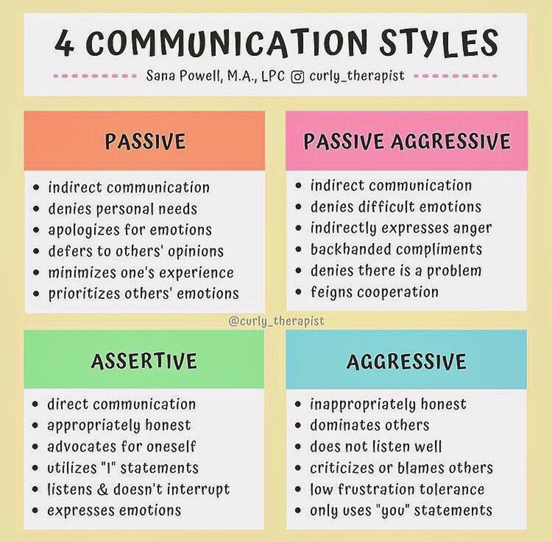
W
WEAKNESSES
Whe
T
THREATS
What are the blockers you're facing?
What are factors outside of your control?

Slide 27
How does this impact me?
The Director is both Assertive and oriented towards Information and Processes.
The Socializer is Assertive and focused on People and Relationships.
The Relator is comfortable in a Passive and People Context
The Thinker has a mindset of being Passive and Interested in Data and Processes.

Slide 28
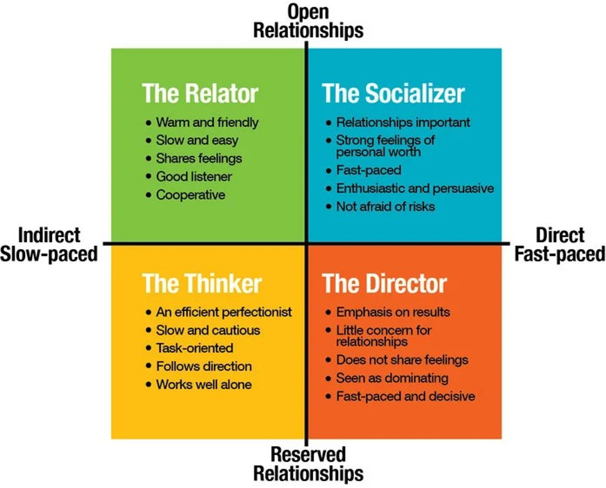

Slide 29
Relator Communication Style Traits
RELATOR TRAITS –
Concerned about stability – show how your ideas/work minimizes risk
Think emotionally – explain your reasoning
Like personal involvement – demonstrate your interest in them
Need to know step by step sequence – provide outline and walk them through the process

Slide 30
Socializer Communication Style Traits
SOCIALIZER TRAITS
Seek enthusiastic people and situations – behave optimistically
Think emotionally – support their feelings
Want to know the general expectations – avoid too many details, focus on the big picture
Want others to notice them – compliments them personally and often

Slide 31
Thinker Communication Style Traits
THINKER TRAITS
Concerned with aggressive approaches – control your tone, speak slowly and smile
Proceed with caution – allow them to think, check on them before to make decisions
Like to contemplate – tell them “why” a decision has been taken
Think logically – give them detailed reasoning behind an action or decision

Slide 32
Director Communication Style Traits
DIRECTOR TRAITS
Want facts and highlights – provide concise data
Strive for results – if you agree with their goals, show support and be proactive
Like personal choices – give them decision-making space
Tendency towards conflicts – argue with conviction on points of disagreement (make sure to be backed up by data).

Slide 33
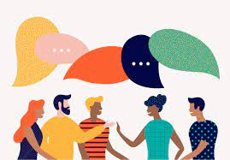
JUST A TIP!
Remember:
Your emotions affect how you interact with others.
Before to enter in a crucial conversation, make sure to be in control of your emotions, so that you will be able to communicate in the way you want to be perceived!

Slide 34
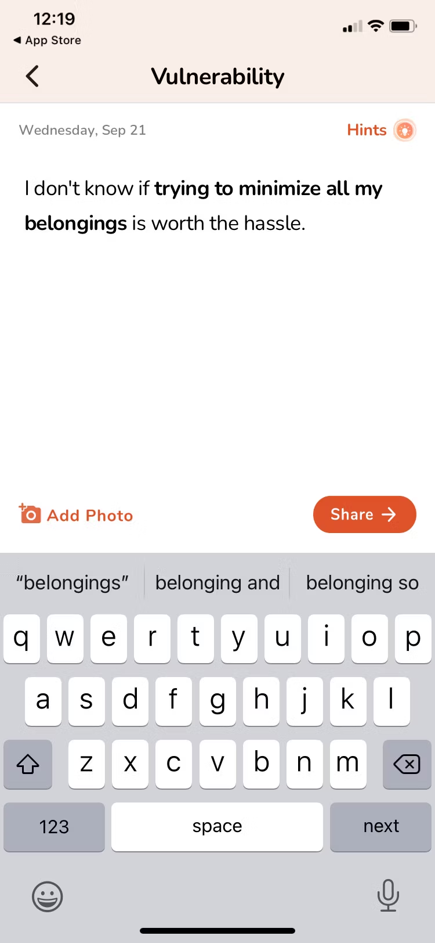
Resources
for Healthy Communication
Use these resources for more help with starting meaningful conversations, reflect on a question a day with family and friends, connect with others to meet new friends, connect with your partner, or learn new communication skills on a professional level
Gather- Conversation Starter
Longwalks: A question each day
Big Talk
Connect with your partner
Mindful communication skills for professional use

Slide 35
@branchesofgrowth
thank you!
@branchesofgrwth

Slide 36
References
https://www.skillsyouneed.com/ips/what-is-communication.html
https://www.pngall.com/disclaimer-symbol-png/download/17713
https://us.humankinetics.com/blogs/excerpt/nonverbal-communication-understanding-the-unspoken
https://marketbusinessnews.com/financial-glossary/kinesic-communication-definition-meaning/#:~:text=Kinesics%20or%20kinesic%20communication%20is,call%20this%20'body%20language
https://link.springer.com/article/10.1007/s00521-016-2522-2
https://blog.gitnux.com/communication-skills-statistics/
https://www.g2.com/articles/what-is-cross-cultural-communication
https://ecosystemsunited.com/2020/06/12/what-is-co-cultural-communication-why-is-co-cultural-communication-important/
https://www.atlassian.com/blog/teamwork/how-to-navigate-diverse-communication-styles-at-work
https://www.javatpoint.com/barriers-of-communication

